Slide 1
DCN PRESENTATION
PRESENTERS:-
ARELIA NALLE KHARJANA
BIBEK SHARMA

Slide 2
CONTENTS
THE BIRTHDAY PROBLEM
HASH FUNCTIONS
PROBABILITY OF HASH COLLISIONS
THE BIRTHDAY ATTACK
HOW TO AVOID BIRTHDAY ATTACK
REFERENCES

Slide 3

THE BIRTHDAY PROBLEM/PARADOX
In a set of n randomly chosen people, some pair of them will have the same birthday.
What is the probability that atleast two of k randomly selected people have the same birthday?
How large must be k so that the probability is greater than 50 percent?

Slide 4
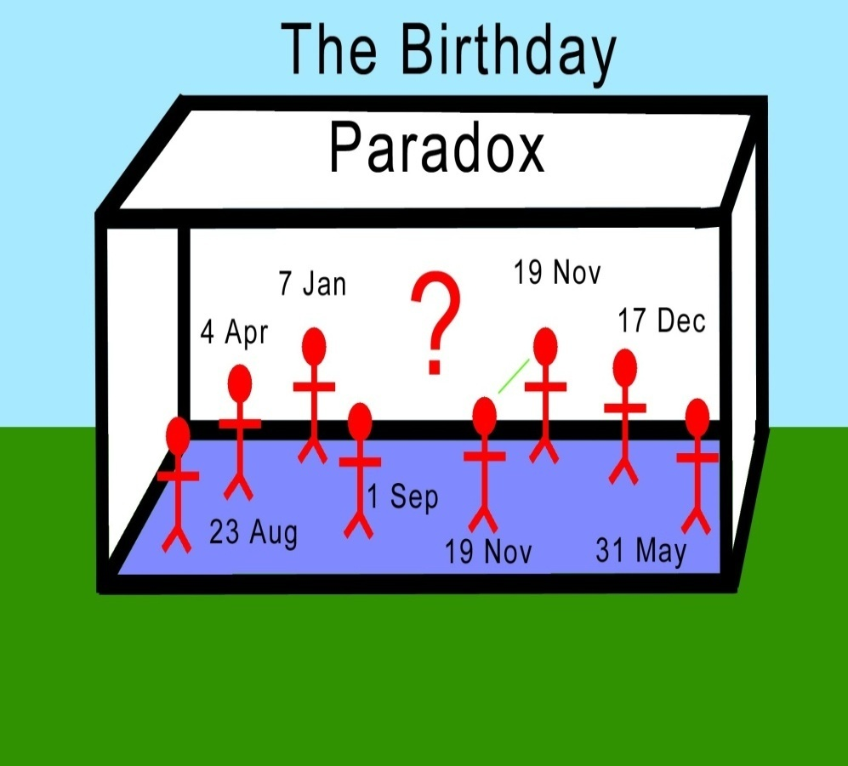
THE BIRTHDAY PROBLEM CONTD…
Problem
In a group of 50 students, what is the probability that at least two students share the same birthday?
Assumptions
Only 365 days each year.
Birthdays are evenly distributed throughout the year, so that each day of the year has an equal chance of being someone’s birthday.

Slide 5
Take group of 5 people….
Let A = event no one in group shares same birthday.
Then A^{C} = event at least 2 people share same birthday.
Assuming independence and using classical approach:
P(A) = 365/365 × 364/365 × 363/365 × 362/365 × 361/365
= 0.973
So, then P(A^{C}) = 1 - 0.973 = 0.027
That is, about a 3% chance that in a group of 5 people at least two people share the same birthday

Slide 6
Take group of 23 people….
Let A = event no one in group shares same birthday.
Then A^{C} = event at least 2 people share same birthday.
Assuming independence and using classical approach:
P(A) = 365/365 × 364/365 × … × 343/365
= 0.493
So, then P(A^{C}) = 1 - 0.493 = 0.507
That is, about a 51% chance that in a group of 23 people at least two people share the same birthday.

Slide 7
Take group of 50 people….
Let A = event no one in group shares same birthday.
Then A^{C} = event at least 2 people share same birthday.
Assuming independence and using classical approach:
P(A) = 365/365 × 364/365 × … × 316/365
= 0.03
P(A^{C}) = 1 - 0.03 = 0.97
That is, about a 97% chance that in a group of 50 people at least two people share the same birthday.

Slide 8
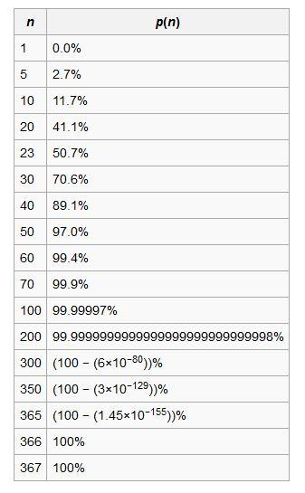
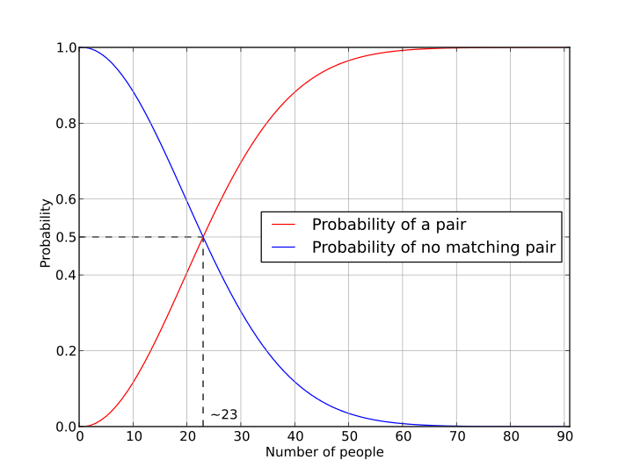
THE BIRTHDAY PROBLEM
If n ≥ √365 then this probability is more than half.
In general, if there are k possibilities then on average √𝑘 trials are required to find a collision.

Slide 9
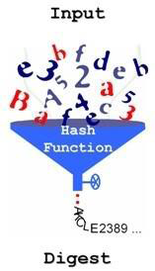
HASH FUNCTIONS
A hash function takes a variable length message M and produces a fixed length message digest.
If the length of the digest is m then there are 2^{𝑚} possible message digests.
More than one message will be mapped to the same digest.

Slide 10
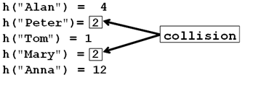
Probability of Hash Collisions
If we apply k random messages to our hash code what must the value of k to have probability of 0.5 that at least one duplicate?
Using previous equation, we have k = √2^{𝑚} = 2^{𝑚/2}

Slide 11
BIRTHDAY ATTACK
Exploits the mathematics behind the birthday problem in probability theory
This attack can be used to abuse communication between two or more parties
The attack depends on higher likelihood of collisions found between random attack attempts and a fixed degree of permutations as described in birthday problem
Birthday attacks are a class of brute force techniques that target the cryptographic hash functions
The goal is to take a cryptographic hash function and find two different inputs that produce the same outputs

Slide 12
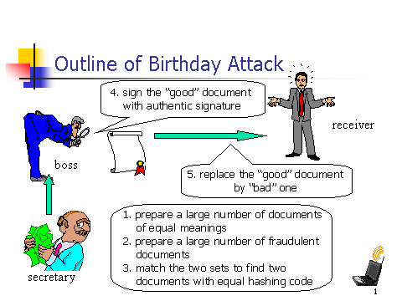
BIRTHDAY ATTACK CONTD…

Slide 13
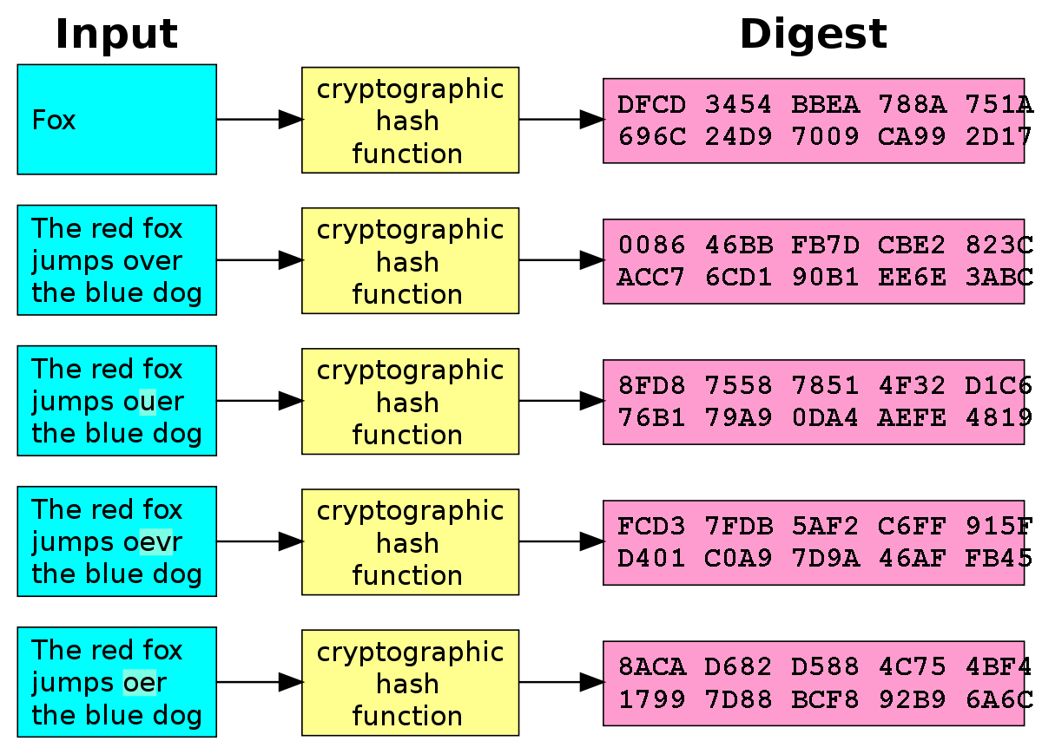
BIRTHDAY ATTACK CONTD…
Consider a hash function that gets an arbitrary message and outputs a n-bit digest
There are 2^{𝑛} possible digests
Then we need to try an average of 2^{𝑛/2} messages to find two with the same digest.
For a 64-bit digest, this requires 2³² tries

Slide 14
BIRTHDAY ATTACK CONTD…
A is prepared to “sign” a message by appending the appropriate m-bit hash code and encrypting that hash code with A’s private key
An attacker generates 2^{𝑚/2} variations on the message, all of which gives the same meaning
The attacker prepares an equal number of messages, all of which are variations of the fraudulent message to be substituted for the real one
The two sets of messages are compared to find a pair of messages that produce the same hash code. The probability of success is greater than 0.5.
If no match is found, additional valid and fraudulent messages are generated until a match is made

Slide 15
BIRTHDAY ATTACK CONTD…
The attacker offers the valid variation to A for signature. This signature can then be attached to the fraudulent variation for transmission to the intended recipient
Because the two variations have the same hash code, they will produce the same signature; the attacker is assured of success even though the encryption key is not known

Slide 16
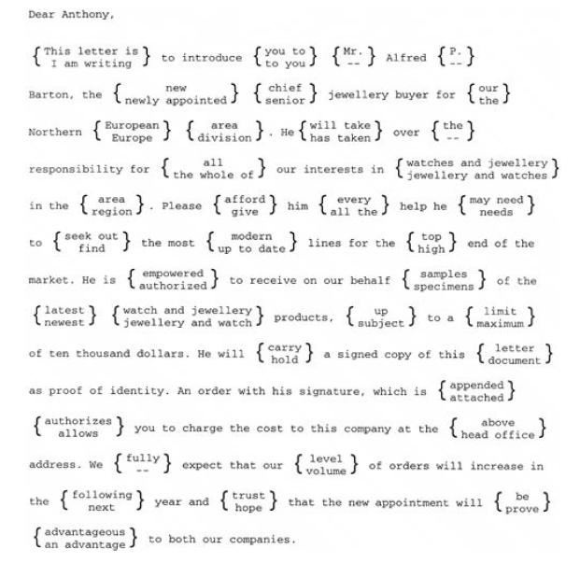
Example of a birthday attack
Figure 2. A Letter in 2³⁷ Variations

Slide 17
How to avoid birthday attack?
To avoid this attack, the output length of the hash function used for a signature scheme can be chosen large enough so that the birthday attack becomes computationally infeasible
For a 128-bit digest, this requires 2⁶⁴ (~1019) tries. (That is computationally infeasible.)

Slide 18
TOPICS ALLOCATION
THE BIRTHDAY PROBLEM ,HASH FUNCTIONS, PROBABILITY OF HASH COLLISIONS →DONE BY BIBEK SHARMA
THE BIRTHDAY ATTACK, HOW TO AVOID BIRTHDAY ATTACK→ DONE BY ARELIA NALLE KHARJANA

Slide 19
REFERENCES
http://www.winlab.rutgers.edu/comnet2/Reading/documents/Birthday_attack.pdf
https://www.slideshare.net/RkskEkanayaka/birthday-paradox-explained
Computer Networks, Fourth Edition By Andrew S. Tanenbaum
Cryptography and Network Security Principles and Practices, Fourth Edition By William Stallings

Slide 20


